Slide 1

Department of Information Technology
NBA Accredited A.P. Shah Institute of Technology G.B.Road, Kasarvadavli, Thane(W), Mumbai-400615 UNIVERSITY OF MUMBAI Academic Year 2022-2023

Slide 2
A Project Report on Integrating Recommendation System to Creative Learning Web Framework
Submitted in partial fulfillment of the degree of Bachelor of Engineering(Sem-8) in INFORMATION TECHNOLOGY By
Ruchita Raut (19104033) Kushal Todi (19104047) Pratik Dhumal (19104031) Under the Guidance of Prof. Geetanjali Kalme

Slide 3
1.Project Conception and Initiation

Slide 4
1.1 Abstract
The Internet has an enormous amount and variety of educational resources. As multidisciplinary educational interest grows, it is becoming increasingly important to support students’ course choices.
Our project implements a course recommendation system using the K-Nearest Neighbors (KNN) algorithm. This system takes into account the preferences and interests of students, and ratings and recommends courses based on their similarity to aid students’ decision-making.
In this algorithm, the cosine similarity metric is used in accordance with the history of students’ course selection records, and better accuracy is obtained in the recommendation task, which satisfies user needs.
This system employs hybrid recommendation approaches from an algorithmic standpoint.

Slide 5
1.2 Objectives
To build and provide a user-friendly interface for web-based application using ReactJS.
To build a collaborative recommendation system on the user’s first enrollment(sign up) category selection inputs using the KNN algorithm along with cosine similarity metrics.
To build a hybrid recommendation system on the basis of the user’s past data i.e category selection, courses, and ratings using the KNN algorithm along with cosine similarity metrics.
To filter recommended/searched courses on the basis of various attributes.

Slide 6
1.3 Literature Review
Sr.No | Title | Authors | Findings
1. | Improved course recommendation algorithm based on collaborative filtering | Zheng Chen | Has proposed a recommendation algorithm based on collaborative filtering for the course recommender to help students’ decisions. In this algorithm, the improved cosine similarity is used, according to the history of students’ course selection records, and better accuracy is obtained in the recommendation task, which meets the needs of users.
2. | An Efficient Framework of Hybrid Recommendation System | Tessy Badriyah; Yunaz Gilang Ramadhan; Iwan Syarif | Has proposed a recommendation system developed which is expected to be able to solve cold-start problem when there is no other relevant data to be recommended for the new added product and also the sparsity problem

Slide 7
1.3 Literature Review (Contd.)
Sr.No | Title | Authors | Findings
3. | Recommendation System for Elective Courses using Content-based Filtering and Weighted Cosine Similarity | Y. Adilaksa and A. Musdholifah | The author combined both the CF and CB models to create a hybrid recommender system for Course Recommendation in the Social Learning network. Here, the Lasso algorithm was proposed for content-based filtering while the KNN algorithm was used for collaborative filtering. In order to amalgamate the results from both filtering techniques, a weighted average method was employed to generate a hybrid result from both filtering models.

Slide 8
1.4 Problem Definition
Integrating a recommendation system to a creative learning web framework using
hybrid recommendation, i.e. using collaborative and content-based algorithms, for better
user experience and solving the problem of scalability of the system.

Slide 9
1.5 Technology stack
- Python (Machine Learning)
- React JS
- PostgreSQL
- Express
- NodeJS
- JWT
- Postman

Slide 10
1.6 Benefits for environment & Society
Reduced Carbon Footprint: By providing personalized course recommendations, the system can help students avoid taking unnecessary courses or repeating courses they have already completed. This can help reduce the number of students commuting to and from classes, thereby reducing the carbon footprint of the institution.
Enhanced Learning Outcomes: The Course Recommendation System can help students identify and enroll in courses that align with their interests, strengths, and career goals. This can lead to improved academic performance, higher graduation rates, and better job prospects, ultimately benefiting society as a whole.

Slide 11
2. Project Design

Slide 12
2.1 Proposed System
Existing research on recommendation system often uses methods such as fuzzy reasoning and genetic algorithms to solve the sparsity and cold start problems, while ignoring the fuzziness of users’ choices.
The proposed KNN hybrid course recommendation system combines collaborative filtering with content-based filtering to improve the accuracy and relevance of course recommendations for users.
The KNN algorithm is used to identify similar users and courses, and a cosine similarity metric is used to measure the similarity between courses based on their features.

Slide 13
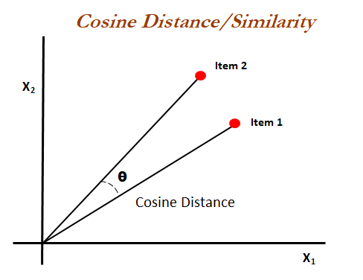
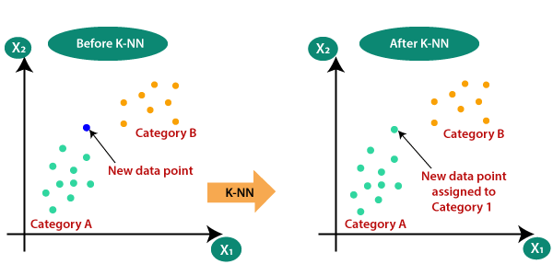
2.1 Proposed System
The system provides personalized course recommendations to users based on their ratings and interests, as well as the similarity of courses and other users. Overall, the system aims to enhance the user experience and satisfaction with the online course platform.
Fig. 2.1.1: Cosine Similarity Fig 2.1.2: KNN Algorithm

Slide 14
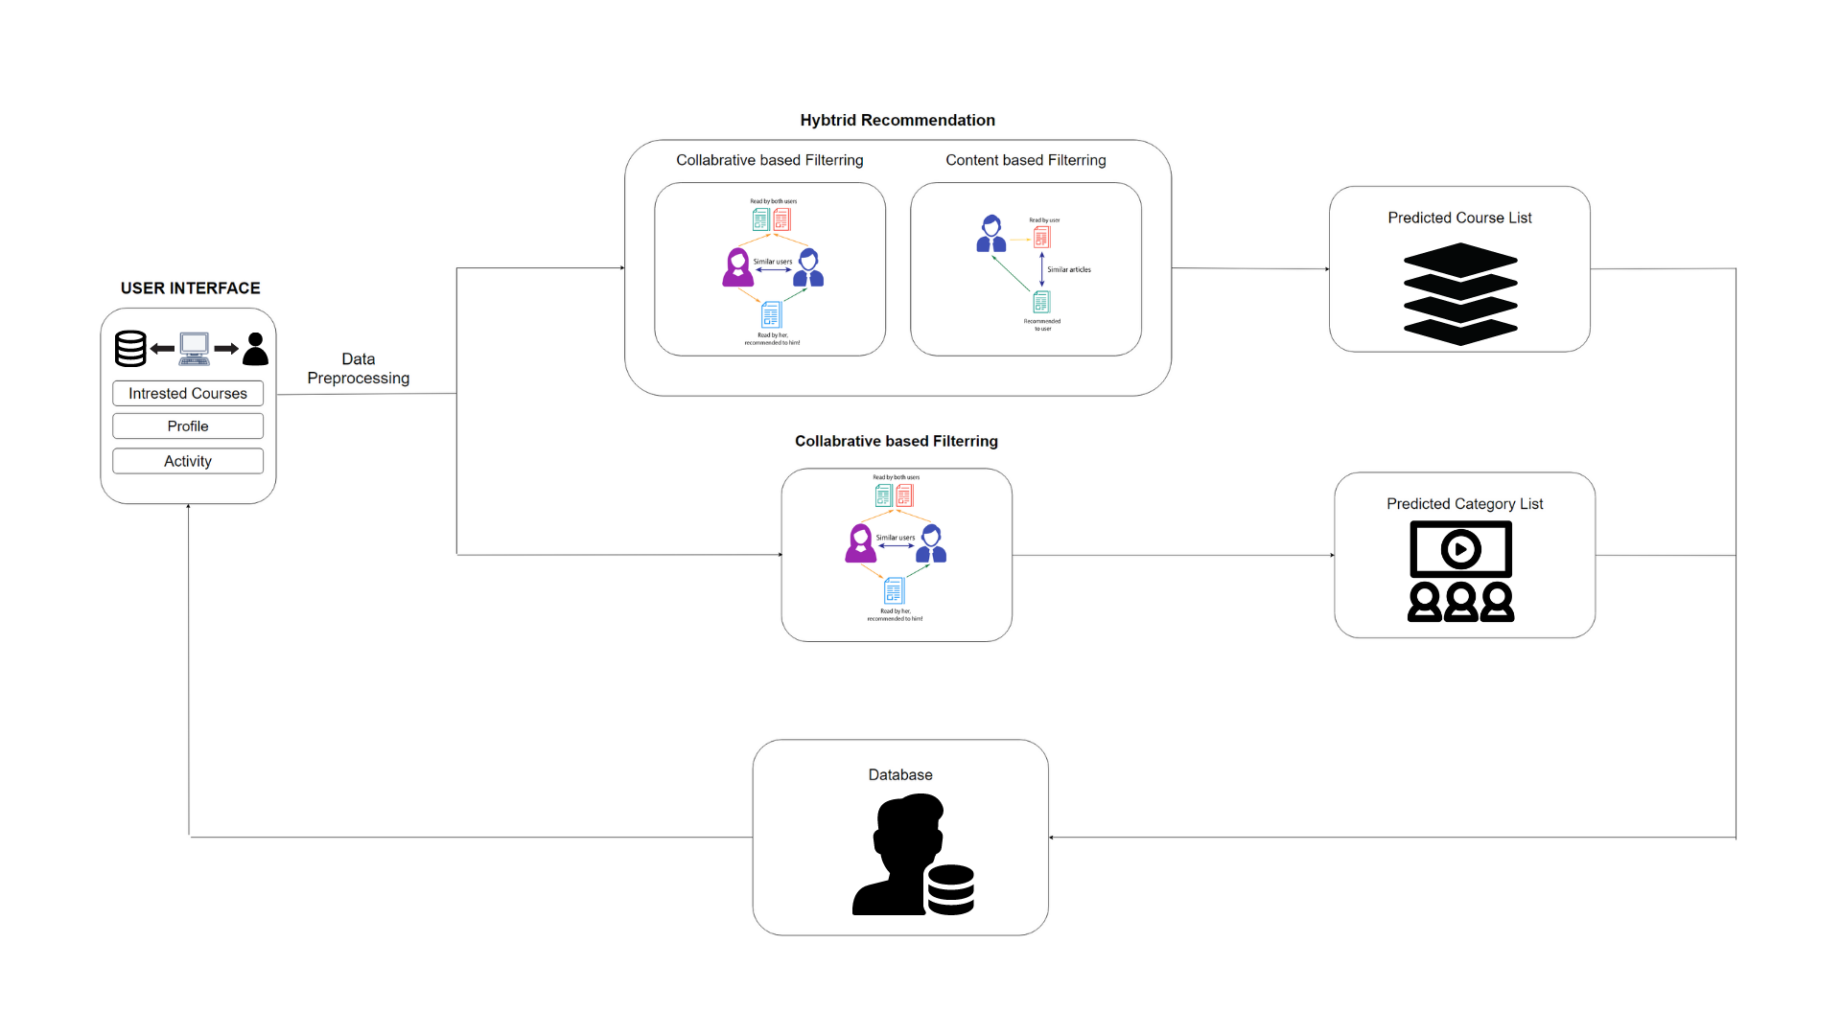
2.1 Proposed System
Fig. 2.1.3 - Architecture of the Hybrid Recommendation System

Slide 15
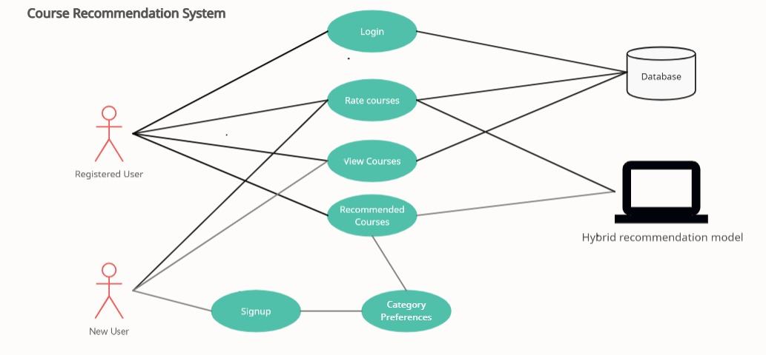
2.2 Use Case Diagram
Fig. 2.2.1 – Use Case Diagram

Slide 16
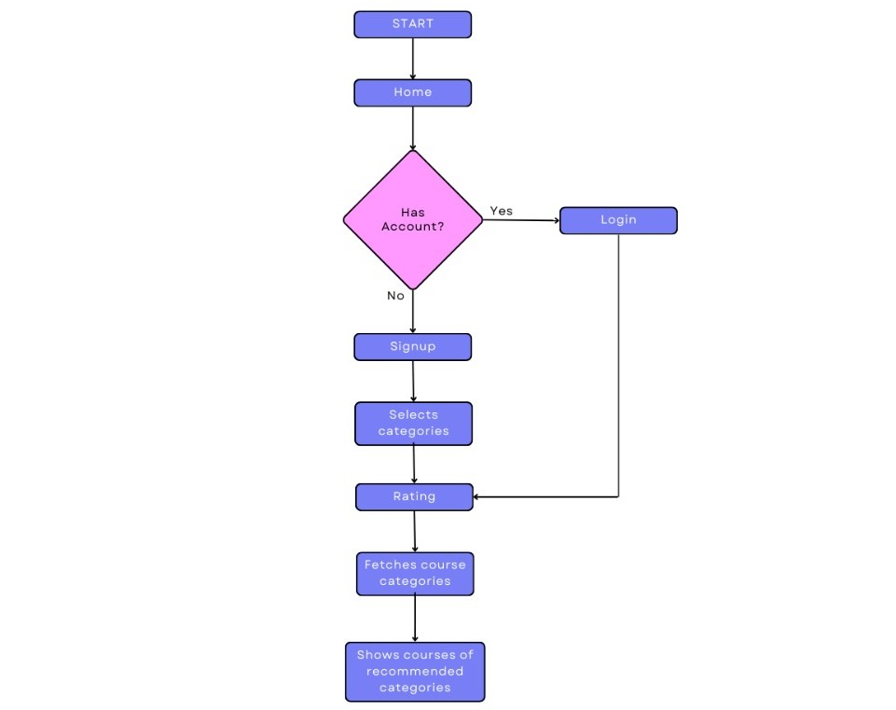
2.3 Activity diagram
Fig. 2.3.1 – Activity Diagram

Slide 17
3. Implementation

Slide 18
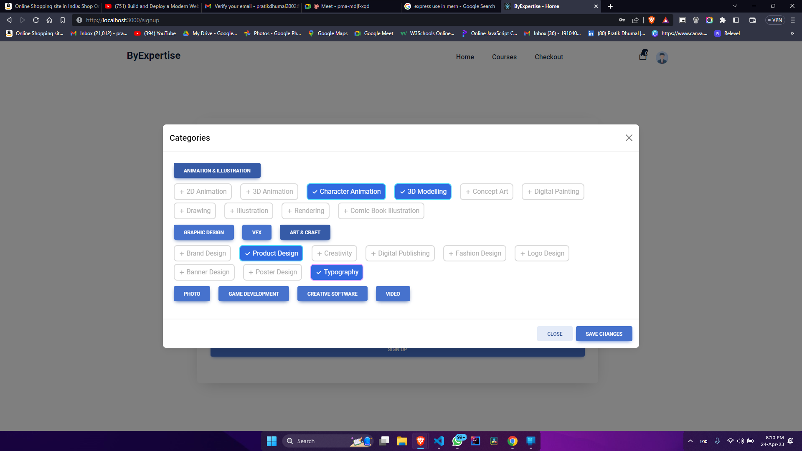
Fig 3.1: User-Interested Categories

Slide 19
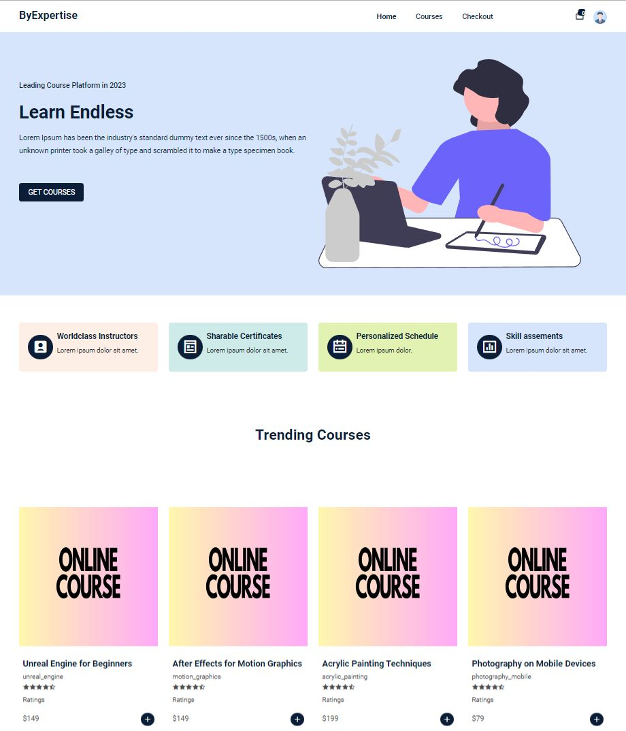
Fig 3.2: Course Catalogue Page

Slide 20
4. Testing

Slide 21
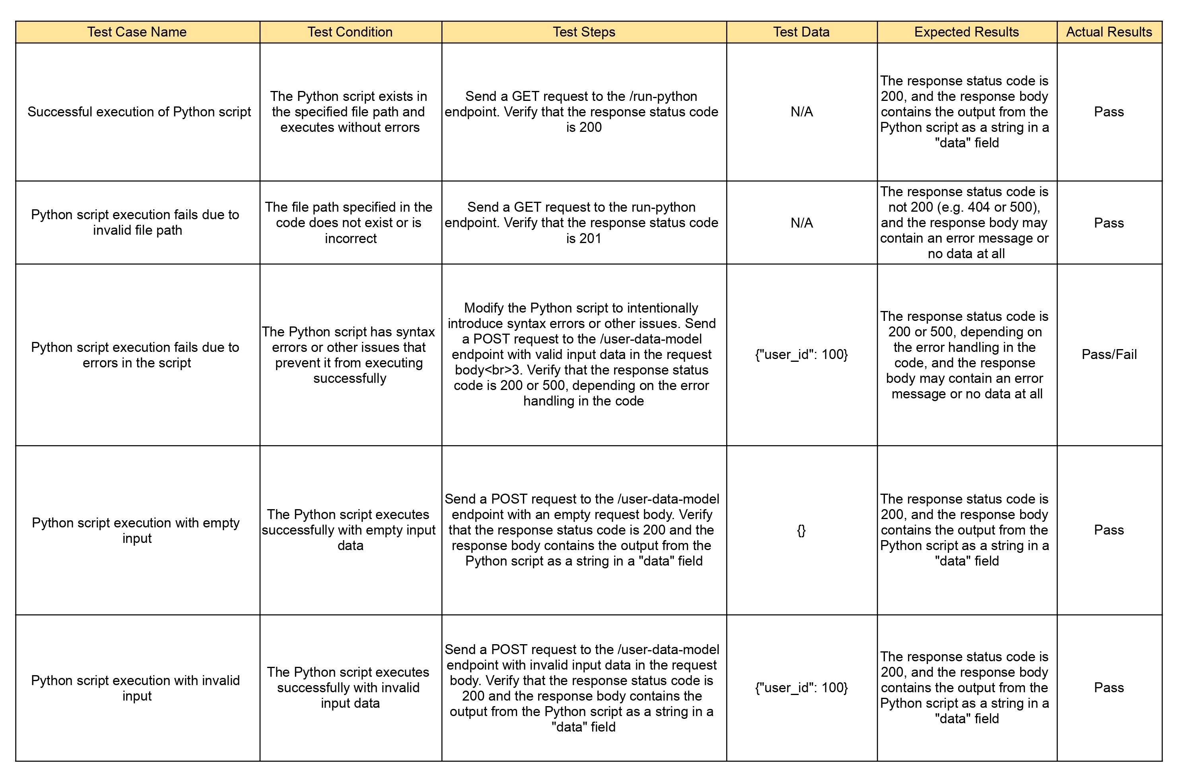
4.1 Test Cases

Slide 22
5. Result

Slide 23
5.1 Result
The designed course recommendation system has shown promising results in improving the accuracy of course recommendations based on user preferences.
In the Recommendation Models, each user is represented as a vector of their past course enrolments or ratings, and the cosine similarity score is calculated between the user's vector and the vectors of other users who have taken comparable courses.
The K users who are most similar to the present user are identified using KNN, and courses that those users have taken or highly rated are recommended to the user.

Slide 24

5.1 Result
Fig. 5.1.1: Hybrid Recommendation Model Output
Fig.5.1.2: Collaborative Recommendation Model Output

Slide 25
6. Conclusion and Future Scope

Slide 26
6.1 Conclusion
A hybrid approach to course recommendation that uses the k-nearest neighbors (KNN) algorithm can overcome the drawbacks of both Collaborative filtering as well as Content-based filtering techniques.
Our developed system, is a course recommendation system based on the KNN algorithm which is easily customizable and adaptable to various data sources and features.
This flexibility makes it an ideal solution for academic institutions, online course providers, and other organizations that want to offer personalized and relevant course recommendations to their users.

Slide 27
6.2 Future Scope
In the future, our designed system can be developed in a way where the system could provide a feedback mechanism for students in real-time and based on that feedback the recommendations will be provided. This could help the system become adaptable and enhance the quality of recommendations.

Slide 28
References
[1] Chen, Zheng; Liu, Xueyue; Shang, Li (2020). [IEEE 2020 International Conference on Big Data and Informatization Education (ICBDIE) - Zhangjiajie, China (2020.4.23-2020.4.25)] 2020 International Conference on Big Data and Informatization Education (ICBDIE) - Improved course recommendation algorithm based on collaborative filtering. , (), 466–469. doi:10.1109/ICBDIE50010.2020.00115
[2] Tessy Badriyah; Yunaz Gilang Ramadhan; Iwan Syarif, 2020 An Efficient Framework of Hybrid Recommendation System based on Multi Mode
[3] Y. Adilaksa and A. Musdholifah, ”Recommendation System for Elective Courses using Content-based Filtering and Weighted Cosine Similarity,” 2021 4th International Seminar on Research of Information Technology and Intelligent Systems (ISRITI), Yogyakarta, Indonesia, 2021, pp. 51- 55, doi: 10.1109/ISRITI54043.2021.9702788.

Slide 29
Paper Publication
The paper entitled “Developing Recommendation System for Creative Learning Web Framework” is “ACCEPTED” at “IC3SEA 2023: International Conference on Contemporary Challenges in Science and its Engineering Applications” by “Ruchita Raut, Kushal Todi, and Pratik Dhumal ”.

Slide 30
Thank You

